Slide 1

Transforming CI Failures into Focused Debugging with Visual Studio Playlists and AI
essentialcsharp.com
Benjamin Michaelis

Slide 2
Where are we headed?
01
02
03
The Demo
THE BUILD STORY
The Bigger Picture
How it works: CI failure → VS debugging
From zero knowledge to working tool
What this means for solving your daily frictions

Slide 3
What Are Visual Studio Playlists?

Slide 4
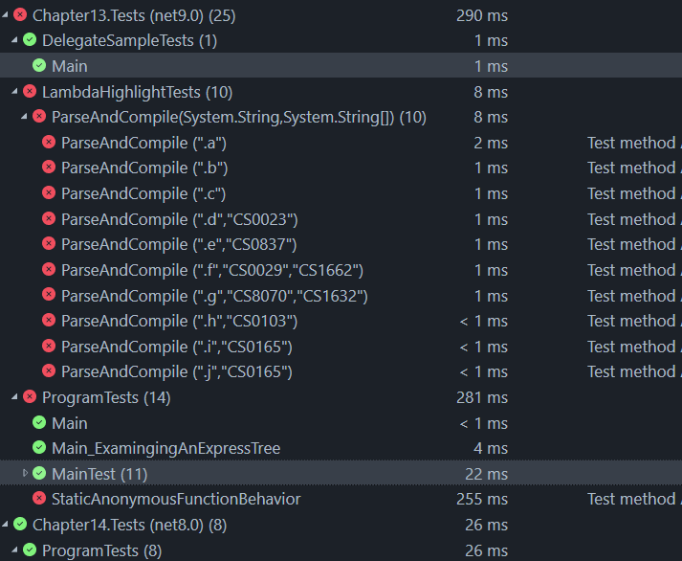
Visual Studio Playlist Files

Slide 5


Visual Studio Playlist Files
Typical Test Explorer Organization
Project1
Feature1_Test1
Feature2_Test1
Feature3_Test1
Project2
Feature1_Test2
Feature4_Test1

Slide 6

Visual Studio Playlist Files
Typical Test Explorer Organization
Visual Studio Playlist
Project1
PlaylistFeature1
Feature1_Test1
Feature1_Test1
Feature2_Test1
Feature1_Test2
Feature3_Test1
Project2
Feature1_Test2
Feature4_Test1

Slide 7
What Are TRX Files?

Slide 8



The Workflow
CI Pipeline
Local Debugging
CI Pipeline runs Tests
Download & Open in Visual Studio
Some Tests Fail
.NET generates a TRX file
Tool converts TRX -> Playlist
Now you can focus only the failed tests
Playlist gets uploaded as a build artifact

Slide 9
AI Amplifies Your Understanding

Slide 10
Build Small, Verify Fast

Slide 11
Keep It Simple

Slide 12
Working Code First,
Perfect Code Second

Slide 13
What This Represents?

Slide 14


Thank you
Benjamin Michaelis
benjamin.michaelis.net/links
essentialcsharp.com

